Slide 1
Ch05_Asynchronous Concurrent Execution

Slide 2
Contents
01_Introduction
02_Mutual Exclusion
03_Implementing Mutual Exclusion Primitives
04_Software Solution to the Mutual Exclusion Problem
05_Hardware Solution to the Mutual Exclusion Problem
06_Semapores

Slide 3
01_Introduction
Process and Thread (Units of execution)
Concurrent
More than one thread exists in a system at the same time
Two concurrent threads can execute independently, or in cooperation
Execute asynchronously
Operate independently
Occasionally communicate and synchronize to perform cooperative tasks
Discuss the organization and management of systems that support asynchronous concurrent threads

Slide 4
02_Mutual exclusion (1/8)
Mutual exclusion
Incorrect results can occur when there is no access control to the shared variable
Can solve this problem by granting each thread exclusive access to the shared variable
Serializing access to the shared variable
While one thread increments the shared variable, all other threads desiring to do so will be made to wait
When the executing thread finishes accessing the shared variable, the system will allow one of the waiting threads to proceed
As one thread proceeds to update the shared variable, all others are excluded from doing so simultaneously (Mutual Exclusion)

Slide 5
02_Mutual exclusion (2/8-1)
Java Multithreading Case Study, Part II:
- A Producer/Consumer Relationship in Java
Producer/consumer relationship
Producer
Generates data and stores it in a shared object
Consumer
Reads data from the shared object

Slide 6
02_Mutual exclusion (2/8-2)
Java Multithreading Case Study, Part II:
- Unsynchronized Buffer with Producer/Consumer
Producer
Wait for a time interval
Write value to buffer and print the buffer
Repeat 4 times 1.~2.
Write terminating message
Consumer
Wait for a time interval
Read value from buffer and print the buffer
Add read value
Repeat 4 times 1.~3.
Write terminating message
Producer
Consumer
Wait & Set 1
Wait & Get/Sum
Wait & Set 2
Buffer
Wait & Get/Sum
Wait & Set 3
Wait & Get/Sum
Wait & Set 4
Wait & Get/Sum

Slide 7
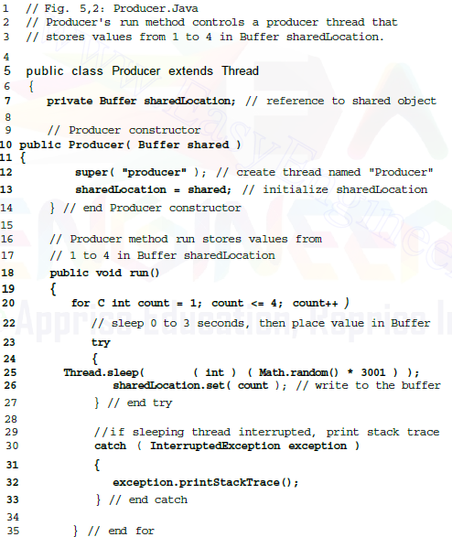
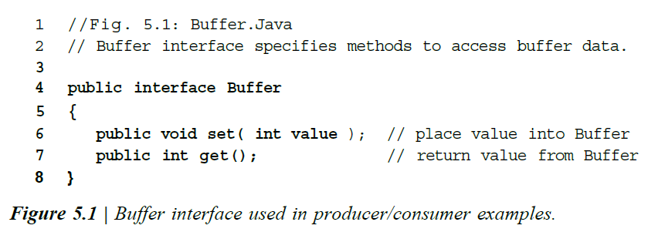
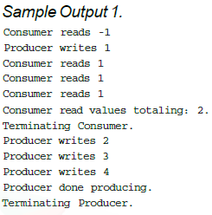
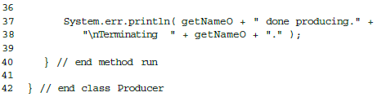
02_Mutual exclusion (3/8)
Buffer Interface & Producer
(

Slide 8
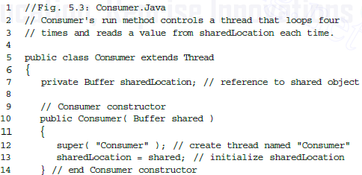
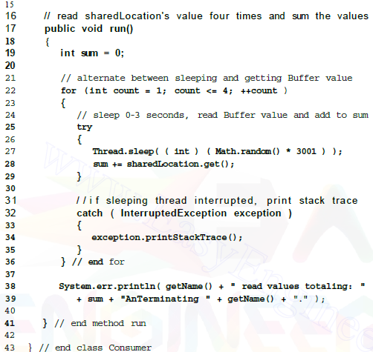
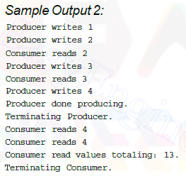
02_Mutual exclusion (4/8)
Consumer

Slide 9
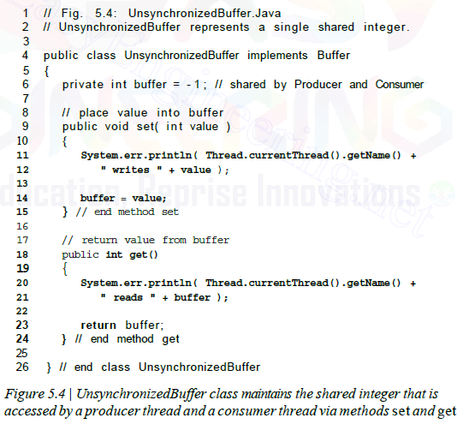
02_Mutual exclusion (5/8)
Unsynchronized Buffer

Slide 10
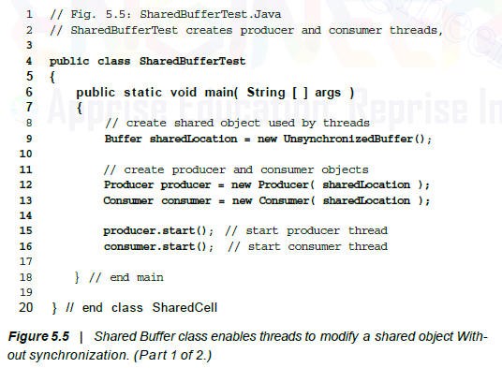
02_Mutual exclusion (6/8)
Shared Buffer Test

Slide 11
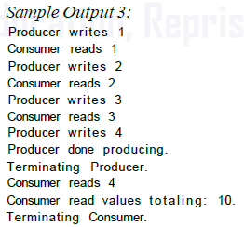
02_Mutual exclusion (7/8)
Sample Output

Slide 12
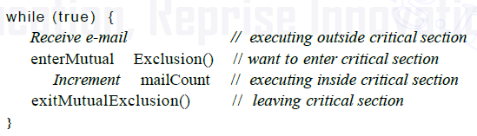
02_Mutual exclusion (8/8)
Critical Sections
Is a code section accessing shared modifiable data
Only one thread at a time can execute the instructions in its critical section for a particular resource
Critical sections must be carefully coded to avoid the possibility of infinite loops
Termination housekeeping
Must release mutual exclusion when a thread in a critical section terminates
Mutual Exclusion Primitives
The most fundamental operations inherent to mutual exclusion
Encapsulate the thread's critical section
enterMutualExclusion()
When a thread wants to enter its critical section
exitMutualExclusion()
When a thread exits the critical section

Slide 13
03_Implementing Mutual Exclusion Primitives
Each mutual exclusion solution in this chapter exhibits the following properties
The solution is implemented purely in software on a machine without specially designed mutual exclusion machine-language instructions.
No assumption can be made about the relative speeds of asynchronous concurrent threads. The rate of execution of each thread may not be constant or predictable
A thread that is executing instructions outside its critical section cannot prevent any other threads from entering their critical sections
A thread must not be indefinitely postponed from entering its critical section

Slide 14
04_Software Solution to the Mutual Exclusion Problem (1/8)
Dekker's Algorithm
First Version (Introducing Lockstep Synchronization and Busy Waiting)
Guarantees mutual exclusion between two threads
Uses a shared variable to which both threads have access
Repeatedly tests the shared variable to see if critical section is free
Busy waiting
Processor time is wasted
Lockstep synchronization problem
If one thread needs to enter its critical section more frequently than the other, the faster thread will be constrained to operate at the speed of the slower thread. The faster thread has to wait until the slower thread completes the critical section.

Slide 15
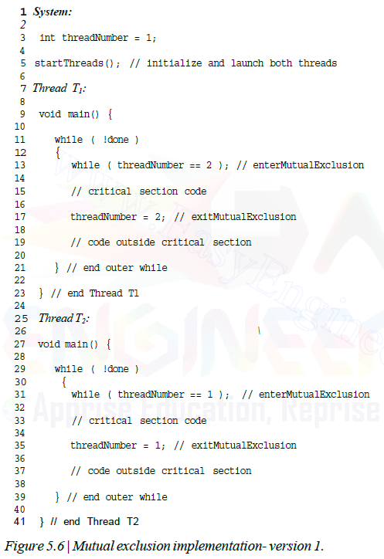
04_Software Solution to the Mutual Exclusion Problem (2/8)
Mutual exclusion
implementation- version 1
(C Pseudo Code)
Start first
Ex) 100 line
Busy Waiting
Ex) 100 line
Lockstep Synchronization
Can not start until T1 is executed
Ex) 10 lines
Ex) 10 lines

Slide 16
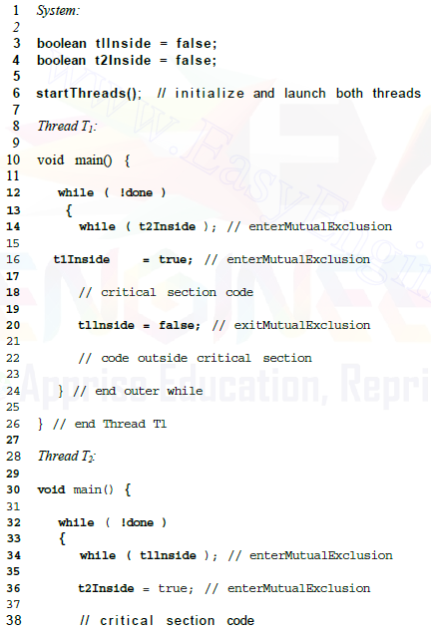
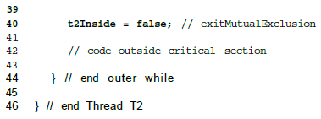
04_Software Solution to the Mutual Exclusion Problem (3/8)
Second Version
- Violating Mutual Exclusion
Eliminate the lockstep synchronization
Maintains two variables
Does not guarantee mutual exclusion
Both threads are concurrently executing
their critical sections
Violating Mutual Exclusion
Can start any thread first
If a preemption is here, then can not guarantee Mutual Exclusion

Slide 17
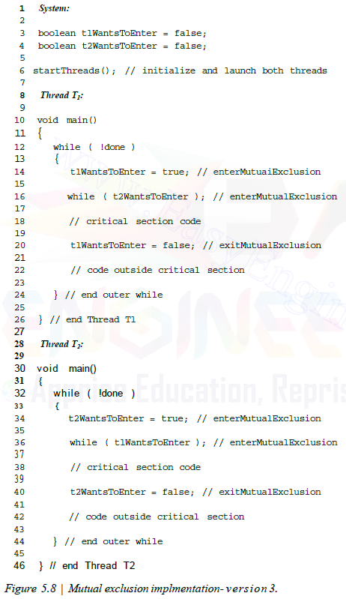
04_Software Solution to the Mutual Exclusion Problem (4/8)
Third Version
- Introducing Deadlock
The thread sets a flag to say
that it is in its critical section
Mutual exclusion is guaranteed
Deadlock
If each thread sets its flag
before proceeding to the while test,
then each thread will find
the other's flag set and will loop forever in the while

Slide 18
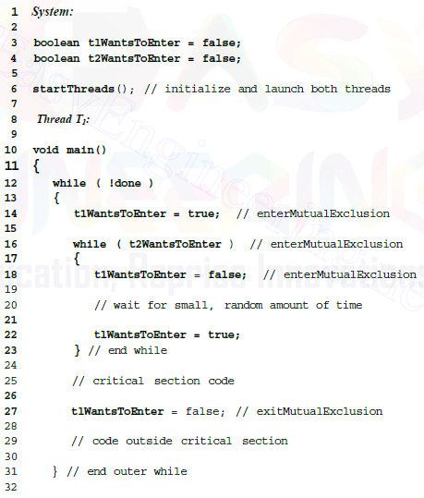
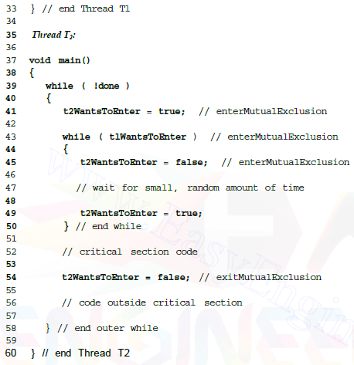
04_Software Solution to the Mutual Exclusion Problem (5/8)
Fourth Version
- Introducing Indefinite Postponement
Each looping thread to repeatedly set its flag
to false for brief periods
Guarantees mutual exclusion
and prevents deadlock
Develop indefinite postponement
e.g., Each thread can proceed in tandem
{
{

Slide 19
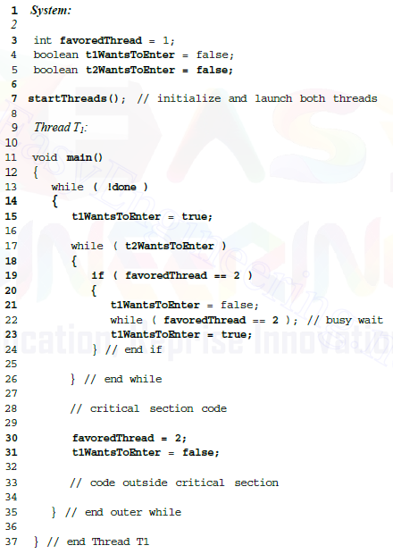
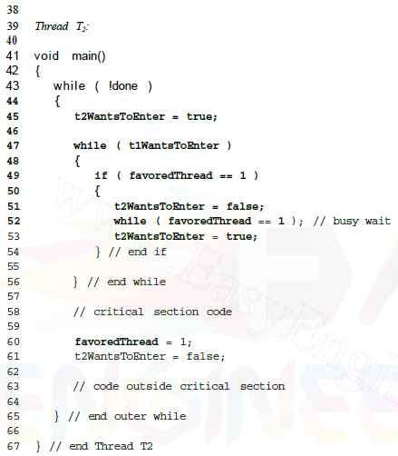
04_Software Solution to the Mutual Exclusion Problem (6/8)
Dekker's Algorithm - A Proper Solution
Incorporates the concept of a "favored thread"
Favored thread enters the critical section when each thread simultaneously wishes to enter its critical section
Resolve conflict issue
Guarantees mutual exclusion
Prevents deadlock and indefinite postponement

Slide 20
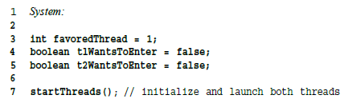
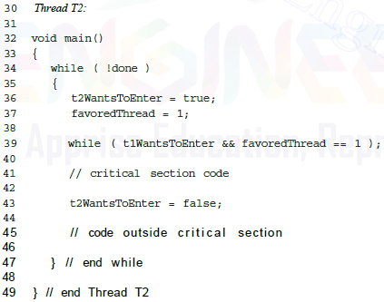
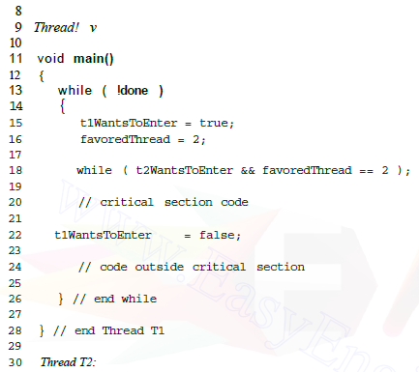
04_Software Solution to the Mutual Exclusion Problem (7/8)
Peterson's Algorithm
A simpler algorithm than Dekker's Algorithm
Use busy wait and favored thread
Guarantees mutual exclusion
Deadlock and indefinite postponement are impossible in Peterson's Algorithm as long as no thread terminates unexpectedly

Slide 21
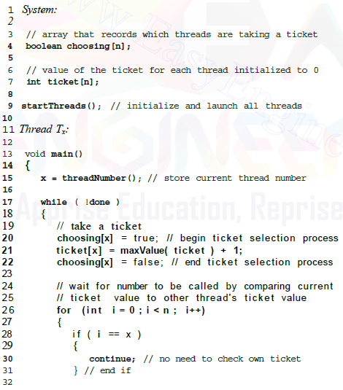
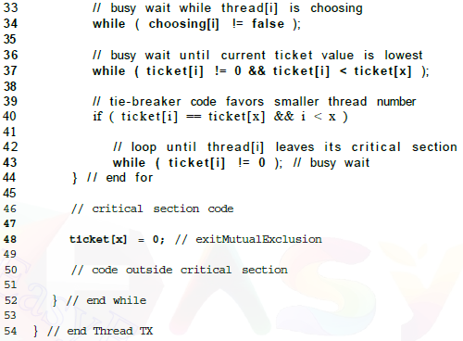

04_Software Solution to the Mutual Exclusion Problem (8/8)
N-Thread Mutual Exclusion:
- Lamport's Bakery Algorithm
Uses a "take-a-ticket" system
Tickets are in ascending order
When a thread possesses a ticket
with the lowest numerical value,
it can enter its critical section
Advantages
The simplest n-thread mutual exclusion algorithms
Can use on multiprocessor systems
Allow FCFS order
Unless multiple threads possess
the same ticket value
No deadlock or indefinite postponement

Slide 22
05_Hardware Solution to the Mutual Exclusion Problem (1/3)
Implement Mutual Exclusion in Hardware
Improve performance and reduce development time
Disabling Interrupts
A simple way to enforce mutual exclusion is to disable (or mask) interrupts
The system will hang
A thread that enters an infinite loop in its critical section after disabling interrupts will never yield its processor
Simply disabling interrupts on uni- or multi-processor is insufficient to enforce mutual exclusion
Test-and-set instruction
The use of special hardware instructions
Enables a thread to perform the operation atomically
Atomic read-modify-write (RMW) memory operations
testAndSet(a,b)
reads the value of b, copy it to a
sets the value of b to true

Slide 23
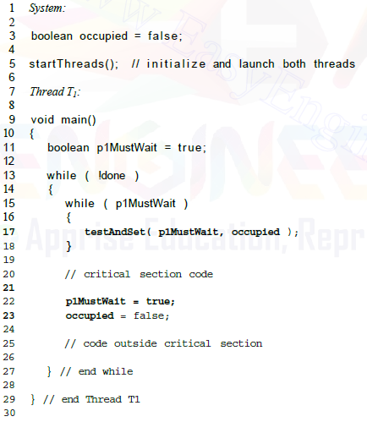
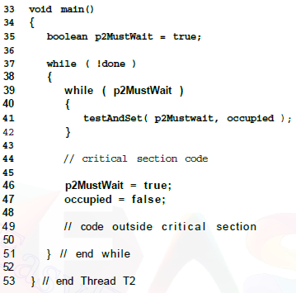
05_Hardware Solution to the Mutual Exclusion Problem (2/3)

Slide 24
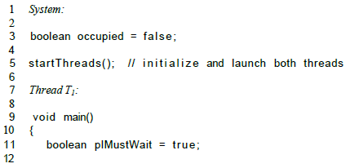
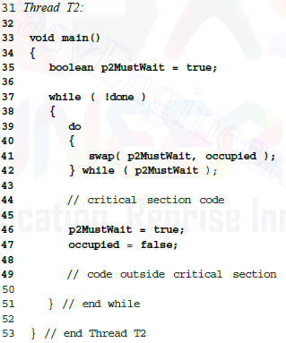
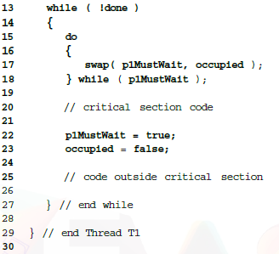
05_Hardware Solution to the Mutual Exclusion Problem (3/3)
Swap Instruction
Provide functionality identical to the testAndSet instruction
Swap the value of a,b atomically
swap(a,b)
loads the value of b into a temporary register
the value of a is copied to b
the value of the temporary register is copied to a

Slide 25
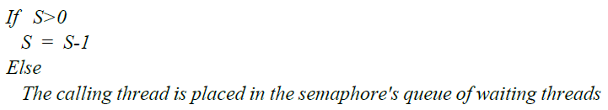
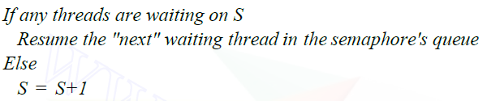
06_Semapores (1/5)
Semaphores
Another mechanism to implement mutual exclusion
Contains a protected variable
Integer value, once initialized, can be accessed and altered by only one of two operations, P and V
When a thread wants to enter its critical section
Call P Operation(S) //wait
When a thread wants to exit its critical section
Call V Operation(S) //signal
Mutual Exclusion with Semaphores
Binary semaphores
Only one thread will be allowed into the critical section at a time when S is 1
P(S)
When a thread calls P, the semaphore's value is reduced to 0
When another thread calls P, that thread will be blocked
V(S)
Calls V after a thread finishes executing in its critical section
The semaphore's value ‘S’is incremented to 1
If any threads are waiting on‘S’, resume the "next" waiting thread in the semaphore's queue
[Note: P and V are short for the Dutch words, proberen, which means "to test," and verhogen, which means "to increment."]

Slide 26
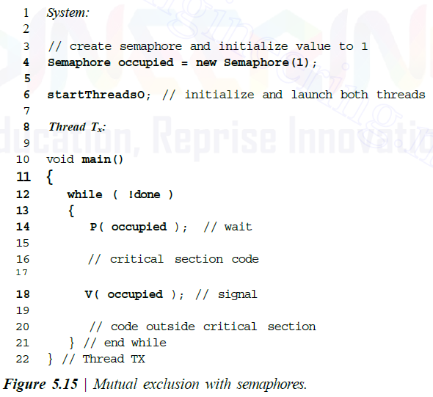
06_Semapores (2/5)

Slide 27
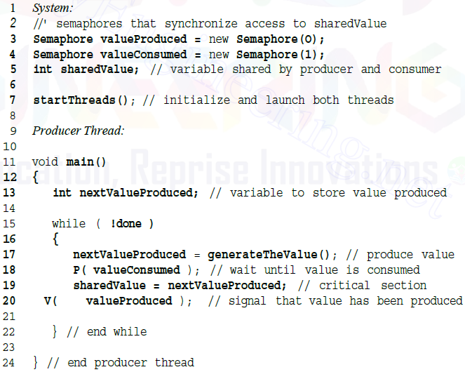
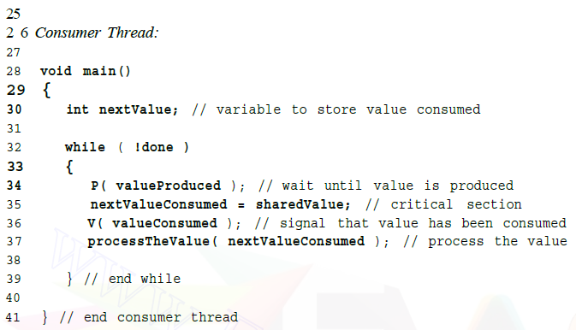
06_Semapores (3/5)
Thread Synchronization with Semaphores
Semaphores
Can be used to synchronize two or
more concurrent threads
The producer/consumer relationship
One example of thread synchronization
Share a variable called sharedValue
Producer
Generates values and
assigns them to sharedValue
Wait for a previously produced value
to be consumed by the consumer
Consumer
Retrieves and processes the values
Wait for a value to be produced
by the producer

Slide 28
06_Semapores (4/5)
Counting Semaphores
A semaphore that is initialized to an integral value greater than zero
Particularly useful when a resource is to be allocated from a pool of identical resources
Initialized to the number of resources in the pool
Each P operation decrements the semaphore by 1
A resource has been removed from the pool and is in use by a thread
Each V operation increments the semaphore by 1
A thread has returned a resource to the pool and the resource may be reallocated to another thread
If a thread attempts a P operation when the semaphore has been decremented to zero
Wait until a resource is returned to the pool by a V operation

Slide 29
06_Semapores (5/5)
Implementing Semaphores
Can be implemented in user applications and in the kernel
Implementing as user applications
Implement Semaphore with busy waiting
Wastes processor cycles
Implementing in the kernel
Avoid busy waiting
Blocking waiting threads to avoid busy waiting
e.g., voluntarily blocks thread itself pending completion of the I/O
Disabling interrupts
Can be used in a uni-processor system in which P, V operation is short
Indivisibility(Atomic Operation) can be ensured
Disadvantage - Could lead to poor performance or even deadlock
Implementing in a multiprocessor system
Approach 1: One of the processors can be given the job of controlling the ready list determining which processors run which threads
Approach 2: Control access (via busy waiting) to a shared ready list

Slide 31
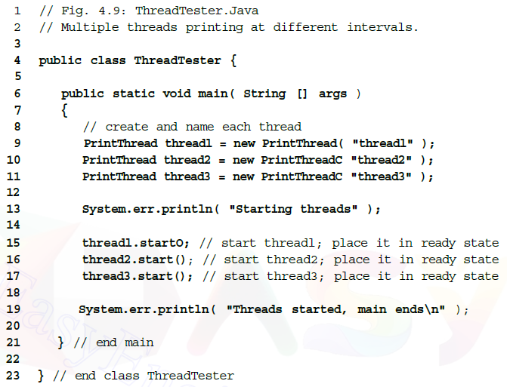
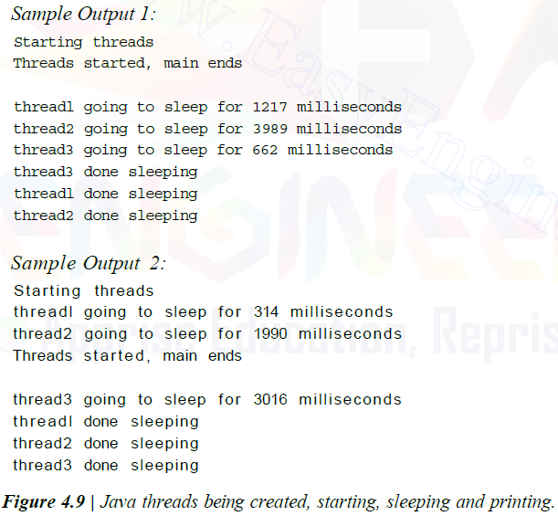
Java Multithreading Case Study, Part I
Java Multithreading Case Study, Part I:
Multiple threads printing at different intervals

Slide 32
